Slide 1
UTILIZATION OF ELECTRICAL ENERGY
UNIT | NAME OF UNIT
1 | Electric Heating and Welding
2 | Illumination Engineering
3 | Electric Drives
4 | Electric Traction
5 | Tariff and Power Factor Improvement

Slide 2
Course Outcomes
CO 1 | Understand mechanism of electric heating and electric welding
CO 2 | Analyze performance of various lighting schemes
CO 3 | Analyze the performance of electric drive systems
CO 4 | Illustrate the different schemes of traction and its main components
CO5 | Understand various tariff methods and power factor improvement techniques.

Slide 3
Electric Heating and Welding
Advantages &applications of Electric heating
Classification of electric heating
Resistance heating
Arc heating
Induction heating
Dielectric heating
Causes of failures of heating elements
Materials for heating elements
Requirement of good heating material
ARC Furnace
Resistance welding
Spot welding, Seam welding
Arc welding
Comparison between AC and DC welding

Slide 4
Illumination Engineering
Introduction, Nature of light
Laws of illumination
Lighting schemes, sources of light
Fluorescent Lamp, CFL and LED
Sodium Vapor Lamps, Neon lamps, Mercury vapor lamps
Comparison between Tungsten & Fluorescent tubes
Requirements of good lighting
Street lighting

Slide 5
Electric Drives
Introduction
Elements of drives, Advantages
Factors affecting selection of motor
Types of loads
Industrial applications
Transient Characteristics of drives
Steady state characteristics of drives
Size of motor
Load Equalization

Slide 6
Electric Traction
Introduction, Requirement of an ideal traction system
Supply system for electric traction
Train movement, Mechanism of train movement
Traction motors
Modern trends in electric traction
Automation in traction
Speed time curves for different services
Trapezoidal and quadrilateral speed time curves
Problems on train movement

Slide 7
Tariff and Power Factor Improvement
Tariff: Desirable characteristics
Types of tariff - Flat rate, Block-rate, KVA maximum demand, Time of Day tariff
Power factor: Disadvantages of low power factor
Advantages of improved power factor
Power factor improvement using static capacitor
Modern trends in electric traction
Most economical power factor
Location of power factor improvement devices from consumer

Slide 8
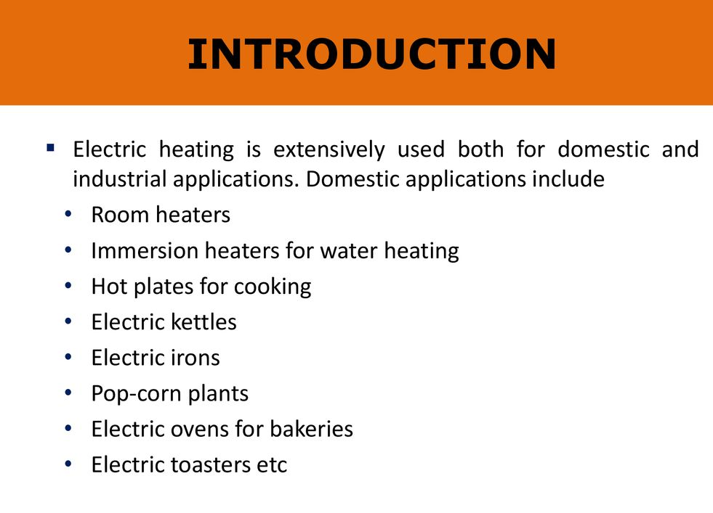

Slide 9
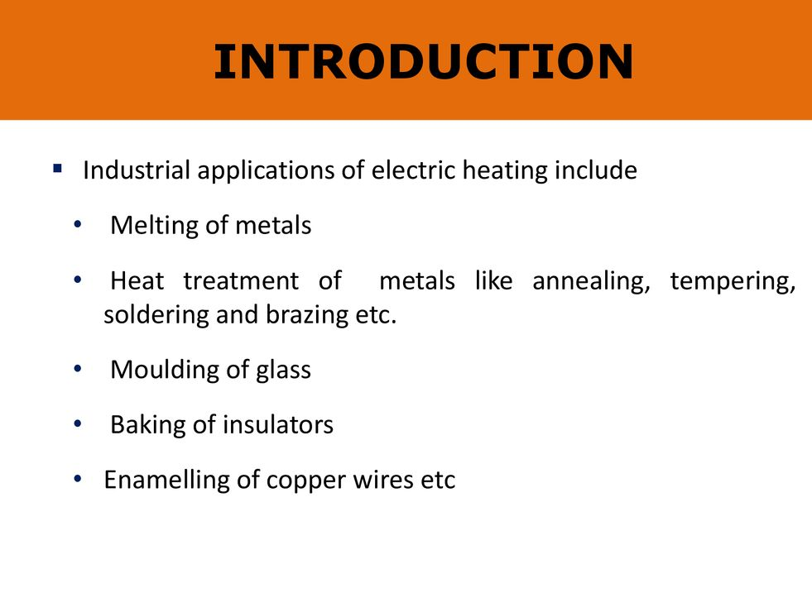

Slide 10
ADVANTAGES OF ELECTRIC HEATING
The various advantages of electric heating over other the types of heating are:
Economical
Electric heating equipment is cheaper; they do not require much skilled persons; therefore, maintenance cost is less.
(ii) Cleanliness
Since dust and ash are completely eliminated in the electric heating, it keeps surroundings cleanly.
(iii) Pollution free
As there are no flue gases in the electric heating, atmosphere around is pollution free; no need of providing space for their exit.
(iv) Ease of control
In this heating, temperature can be controlled and regulated accurately either manually or automatically.
(v) Uniform heating
With electric heating, the substance can be heated uniformly, throughout whether it may be conducting or non-conducting material.
vi) High efficiency
In non-electric heating, only 40–60% of heat is utilized but in electric heating 75–100% of heat can be successfully utilized. So, overall efficiency of electric heating is very high

Slide 11
.
(vii) Automatic protection
Protection against over current and over heating can be provided by using fast control devices.
(viii) Heating of non-conducting materials
The heat developed in the non-conducting materials such as wood and porcelain is possible only through the electric heating.
(ix) Better working conditions
No irritating noise is produced with electric heating and also radiating losses are low.
(x) Less floor area
Due to the compactness of electric furnace, floor area required is less.
(xi) High temperature
High temperature can be obtained by the electric heating except the ability of the material to withstand the heat.
(xii) Safety
The electric heating is quite safe.

Slide 12
Applications of Electric Heating
Domestic & Commercial Applications
Electric heaters, such as room heaters, immersion heaters for water heating, hot plates for cooking, etc.
Electric irons
Electric kettles and coffee percolators
Popcorn plants
Hot air driers for drying wet hairs or laboratory equipment
Electric ovens / electric tandoors / electric toasters

Slide 13
Applications of Electric Heating
Industrial Applications
Melting for extraction or purification of metals.
Heat treatment for various processes such as hardening, normalising, annealing, tempering, soldering, brazing, joining, case hardening, etc.
Enamelling of copper conductor.
Heat treatment of painted surfaces.
Making of plywood.
Making of biscuits, breads, etc.
Baking of potteries or insulators or sanitary fittings.
Moulding of glass for making glass appliances, etc.

Slide 14
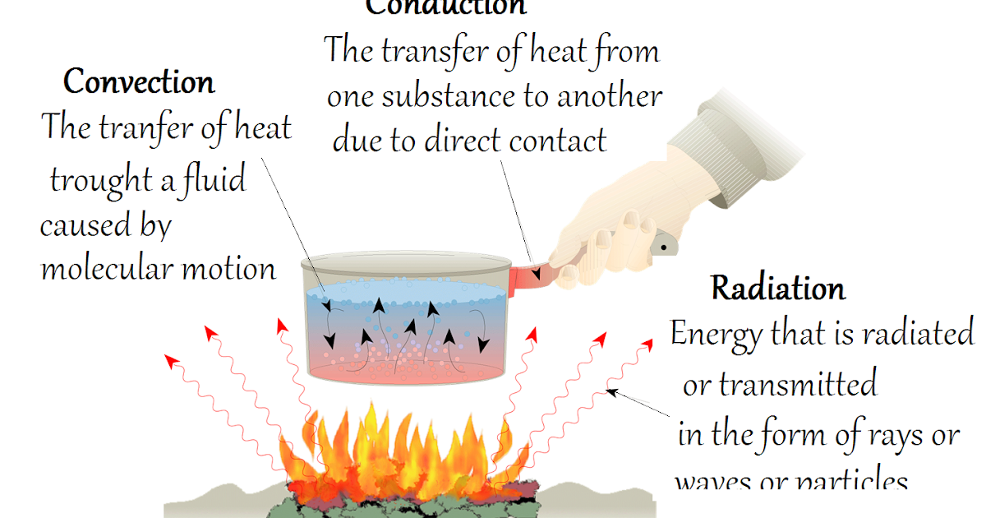

Slide 15
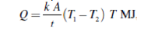
Conduction
In this mode, the heat transfers from one part of substance to another part without the movement in the molecules of substance. The rate of the conduction f heat along the substance depends upon the temperature gradient.
The amount of heat passed through a cubic body with two parallel faces with thickness ‘t’ meters, having the cross-sectional area of ‘A’ square meters and the temperature of its two faces T₁°C and T₂°C, during ‘T’ hours is given by:
where k is the coefficient of the thermal conductivity for the material and it is measured in MJ/m³/°C/hr.
Ex: Refractory heating, the heating of insulating materials, etc.

Slide 16
Convection
In this mode, the heat transfer takes place from one part to another part of substance or fluid due to the actual motion of the molecules. The rate of conduction of heat depends mainly on the difference in the fluid density at different temperatures.
Ex: Immersion water heater.
The amount of heat absorbed by the water from heater through convection depends mainly upon the temperature of heating element and also depends partly on the position of the heater.
Heat dissipation is given by the following expression.
H= a (T₁ – T₂) b W/m²
where ‘a’ and ‘b’ are the constants whose values are depend upon the heating surface and T₁and T₂ are the temperatures of heating element and fluid in °C, respectively.

Slide 17
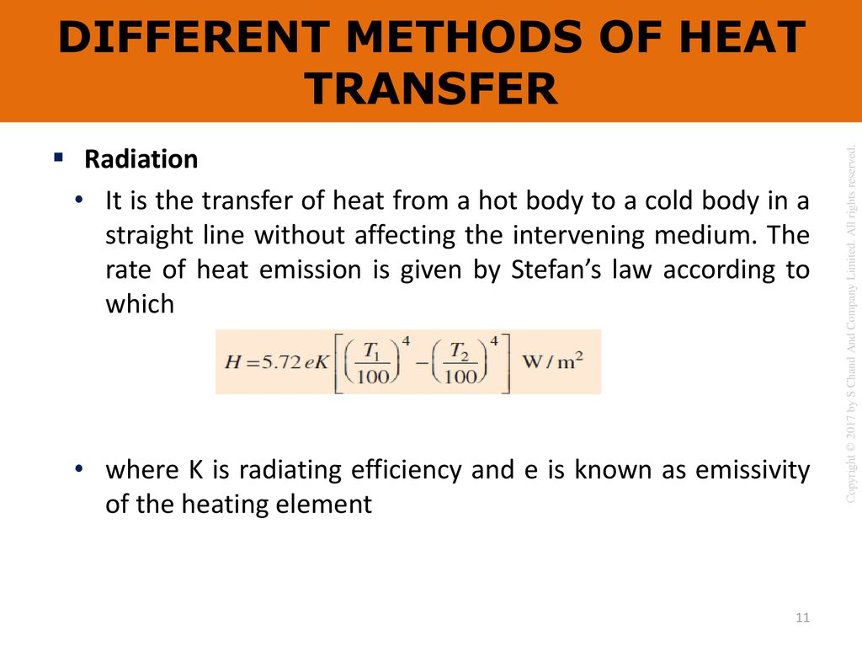

Slide 18
CAUSES OF FAILURE OF HEATING ELEMENTS
Mechanical failure
Oxidation
Formation of hot spots
Corrosion

Slide 19
Mechanical Failure
The mechanical failure of the heating element is mainly due to production of more heat. During the process of alloying, a portion may have a higher content of the higher resistivity constituent. This portion of the element will produce more heat and get failed.
Oxidation
The outermost surface of the heating element gets oxidized at high temperatures. During switching operation, the oxide layer gets flack off and exposing the inner surface to the atmosphere. Now, for the further operation, the inner surface gets oxidized and thus, the effective cross-section at such spots becomes comparatively smaller resulting into formation of hot-spots and finally breakdown.
Formation of Hot-Spots
In case of formation of hot spots, the point of failure of the heating element is the place where the element shines brightest during the operation. This shows that there is a comparatively higher operating temperature at the particular spot as compared to the rest of the element.
Corrosion
If the heating element directly comes in contact with the chemical fumes during industrial operations, this will corrode the region of the element where fumes touch the element. This portion of the element will finally get failed.

Slide 20
ESSENTIAL REQUIREMENTS OF GOOD HEATING ELEMENT
The materials used for heating element should have the following properties:
High-specific resistance
Material should have high-specific resistance so that small length of wire may be required to provide given amount of heat.
High-melting point
It should have high-melting point so that it can withstand for high temperature, a small increase in temperature will not destroy the element.
Low temperature coefficient of resistance
The radiant heat is proportional to fourth powers of the temperatures, it is very efficient heating at high temperature. For accurate temperature control, the variation of resistance with the operating temperature should be very low. This can be obtained only if the material has low temperature coefficient of resistance.

Slide 21
Free from oxidation
The element material should not be oxidized when it is subjected to high temperatures; otherwise the formation of oxidized layers will shorten its life.
High-mechanical strength
The material should have high-mechanical strength and should withstand for mechanical vibrations.
Non-corrosive
The element should not corrode when exposed to atmosphere or any other chemical fumes.
Economical
The cost of material should not be so high.

Slide 22
MATERIAL FOR HEATING ELEMENTS
The selection of a material for heating element is depending upon the service conditions such as maximum operating temperature and the amount of charge to be heated, but no single element will not satisfy all the requirements of the heating elements.
The materials normally used as heating elements are either alloys of nickel–chromium, nickel–chromium–iron, nickel–chromium–aluminum, or nickel–copper.
Nickel–chromium–iron alloy is cheaper when compared to simple nickel–chromium alloy.
The use of iron in the alloy reduces the cost of final product but, reduces the life of the alloy, as it gets oxidized soon.

Slide 23
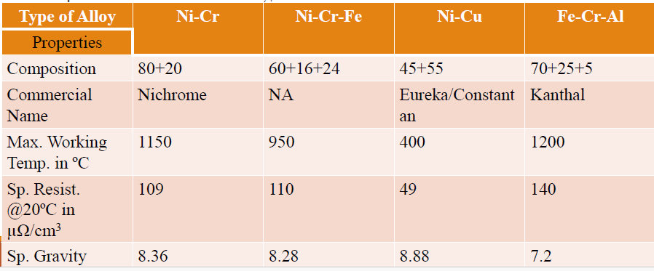
Materials for heating element

Slide 24
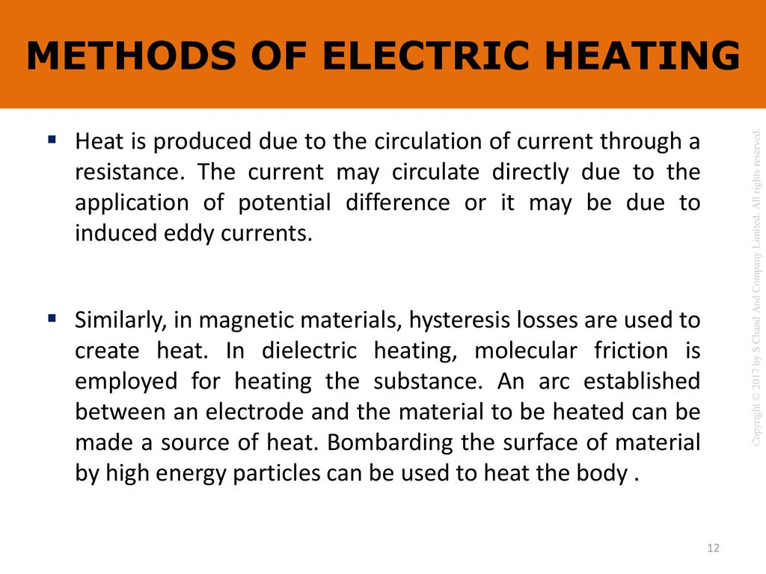

Slide 25
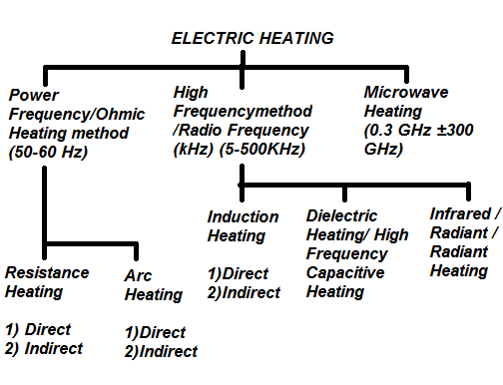
Classification of Electric Heating

Slide 26
Direct resistance heating:
In this method, the electric current is made to pass through the charge (or) substance to be heated. This principle of heating is employed in electrode boiler.
Indirect resistance heating:
In this method, the electric current is made to pass through a wire or high-resistance heating element, the heat so developed is transferred to charge from the heating element by convection or radiation. This method of heating is employed in immersion water heaters.
Direct arc heating:
In this method, by striking the arc between the charge and the electrode or electrodes, the heat so developed is directly conducted and taken by the charge.
The furnace operating on this principle is known as direct arc furnaces. The main application of this type of heating is production of steel.
Indirect arc heating
In this method, arc is established between the two electrodes, the heat so developed is transferred to the charge (or) substance by radiation.
The furnaces operating on this principle are known as indirect arc furnaces. This method is generally used in the melting of non-ferrous metals.

Slide 27
Direct induction heating
In this method of heating, the currents are induced by electromagnetic action in the charge to be heated. These induced currents are used to melt the charge in induction furnace.
Indirect induction heating
In this method, eddy currents are induced in the heating element by electromagnetic action.
Thus, the developed heat in the heating element is transferred to the body (or) charge to be heated by radiation (or) convection.
This principle of heating is employed in induction furnaces used for the heat treatment of metals.
Dielectric heating
In this method of electric heating, the heat developed in a non-metallic material due to inter atomic friction, known as dielectric loss.
This principle of heating usually employed for preheating of plastic performs, baking foundry cores, etc.

Slide 28
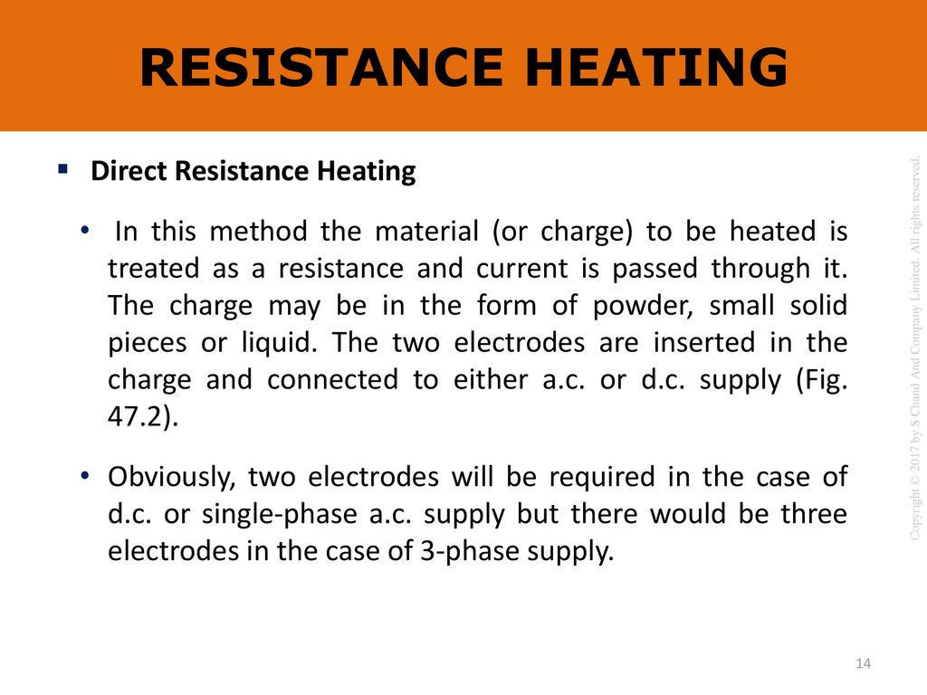

Slide 29
Direct Resistance heating
In this method, electrodes are immersed in a material or charge to be heated.
The charge may be in the form of powder, pieces, or liquid. The electrodes are connected to AC or DC supply.
In case of DC or 1-φ AC, two electrodes are immersed and three electrodes are immersed in the charge and connected to supply in case of availability of 3-φ supply.
When metal pieces are to be heated, the powder of lightly resistive is sprinkled over the surface of the charge (or) pieces to avoid direct short circuit.
The current flows through the charge and heat is produced in the charge itself. So, this method has high efficiency.
As the current in this case is not variable, so that automatic temperature control is not possible.
This method of heating is employed in salt bath furnace and electrode boiler for heating water.

Slide 30
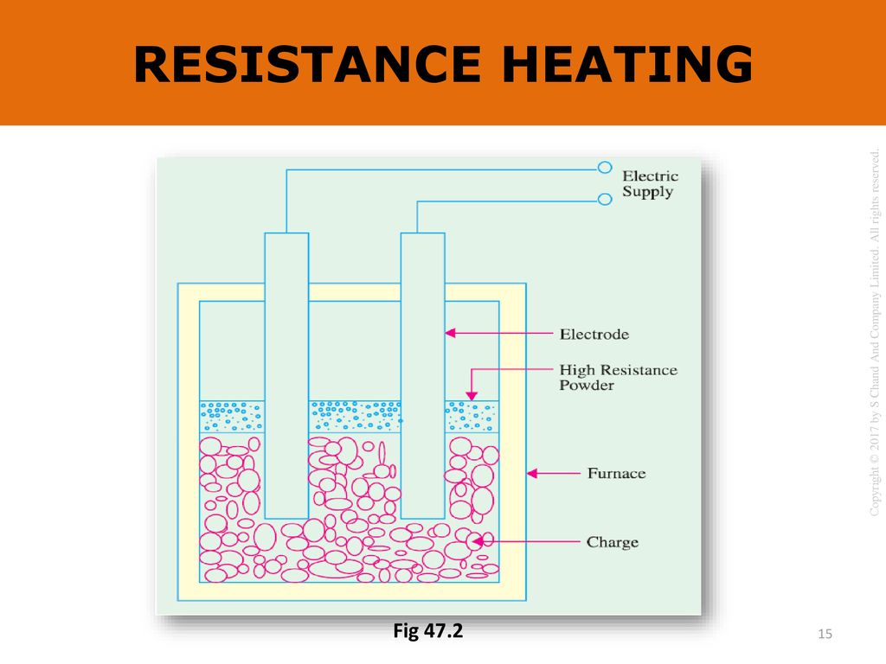

Slide 31
Salt bath furnace
This type of furnace consists of a bath and containing some salt such as molten sodium chloride and two electrodes immersed in it. Such salt have a fusing point of about 1,000–1,500°C depending upon the type of salt used.
When the current is passed between the electrodes immersed in the salt, heat is developed and the temperature of the salt bath may be increased.
Such an arrangement is known as a salt bath furnace. In this bath, the material or job to be heated is dipped.
The electrodes should be carefully immersed in the bath in such a way that the current flows through the salt and not through the job being heated.
As DC will cause electrolysis so, low voltage AC up to 20 V and current up to 3,000 A is adopted depending upon the type of furnaces.
The resistance of the salt decreases with increase in the temperature of the salt, therefore, in order to maintain the constant power input, the voltage can be
controlled by providing a tap changing transformer.
The control of power input is also affected by varying the depth of immersion and the distance between the electrodes.

Slide 32
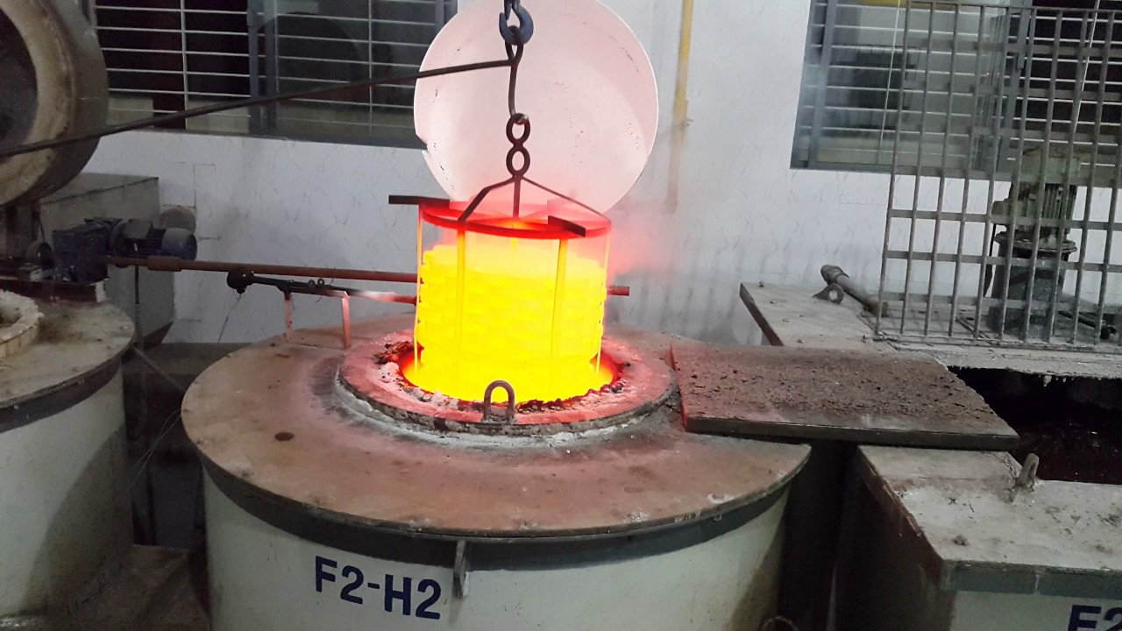
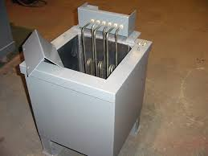

Slide 33
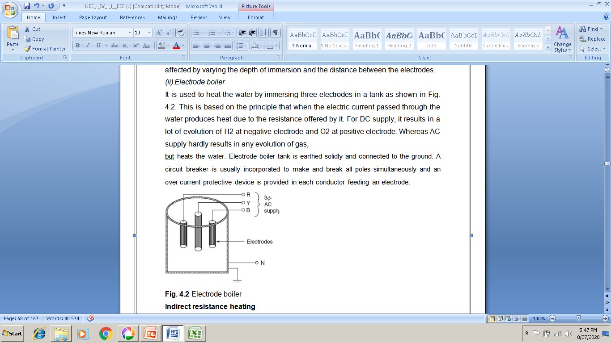
Electrode boiler
It is used to heat the water by immersing three electrodes in a tank.
This is based on the principle that when the electric current passed through the water produces heat due to the resistance offered by it.
For DC supply, it results in a lot of evolution of H₂ at negative electrode and O₂ at positive electrode.
Whereas AC supply hardly results in any evolution of gas, but heats the water.
Electrode boiler tank is earthed solidly and connected to the ground.
A circuit breaker is usually incorporated to make and break all poles simultaneously and an over current protective device is provided in each conductor feeding an electrode.
Advantages:
1. High efficiency.
2. It gives uniform heat and high temperature.
Application:
It is mainly used in salt bath furnace and water heaters.

Slide 34
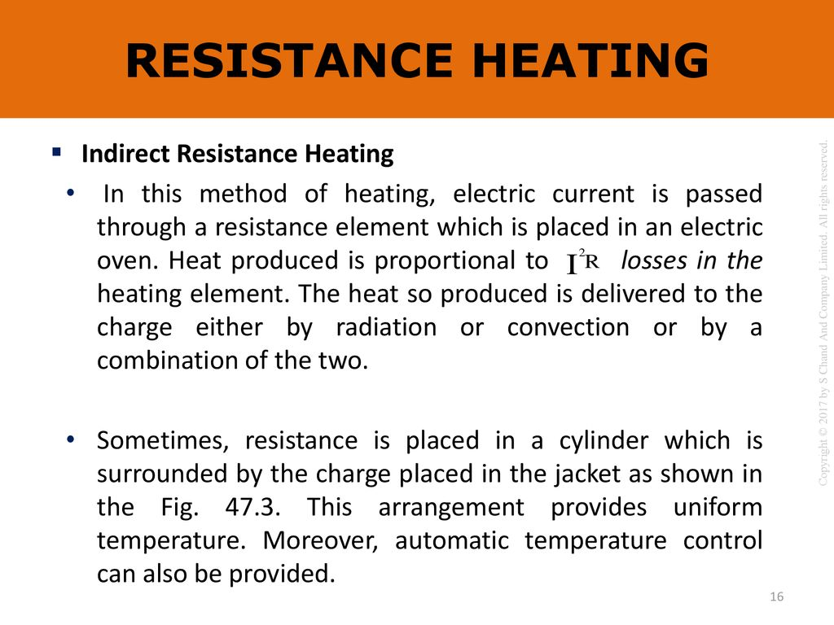

Slide 35
Indirect Resistance heating
In the indirect resistance heating method, high current is passed through the heating element.
In case of industrial heating, some times the heating element is placed in a cylinder which is surrounded by the charge placed in a jacket is known as heating chamber.
The heat is proportional to power loss produced in the heating element is delivered to the charge by one or more of the modes of the transfer of heat viz. conduction, convection, and radiation.
This arrangement provides uniform temperature and automatic temperature control.
Generally, this method of heating is used in immersion water heaters, room heaters, and the resistance ovens used in domestic and commercial cooling and salt bath furnace.

Slide 36
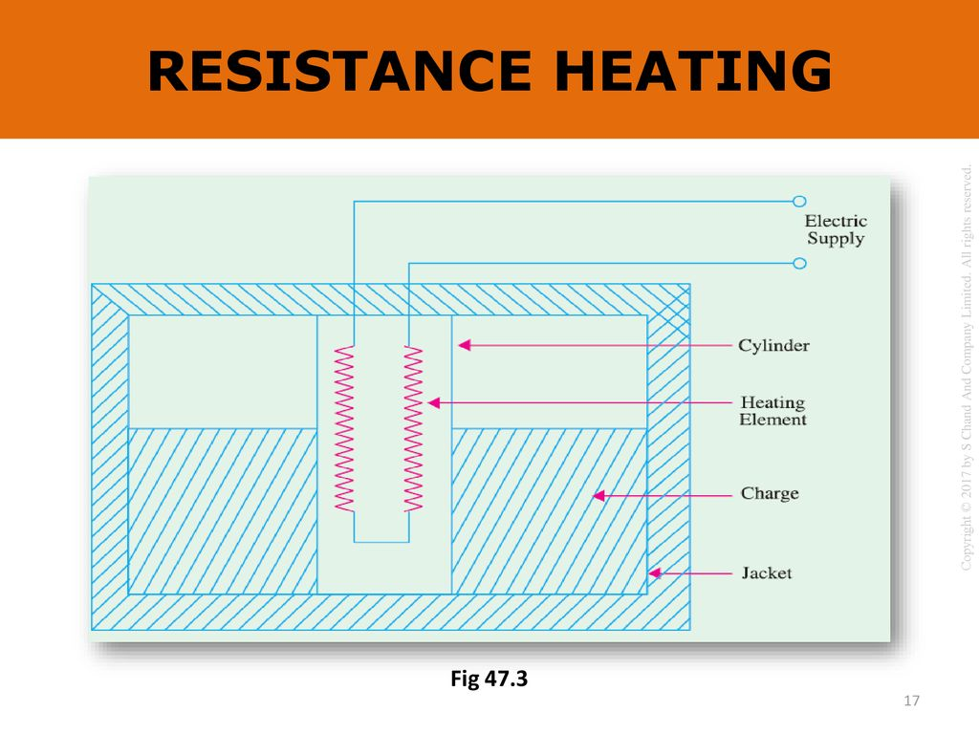

Slide 37
Indirect resistance method is used in
room heater,
in bimetallic strip used in starters,
immersion water heaters and
in various types of resistance ovens used in domestic and commercial cooking.

Slide 38
Arc Heating
If the high voltage is applied across an air gap, the air in the gap gets ionized under the influence of electrostatic forces and becomes conducting medium, current flows in the form of a continuous spark, known as arc.
A very high voltage is required to establish an arc but very small voltage is sufficient to maintain it, across the air gap.
The high voltage required for striking an arc can be obtained by using a step-up transformer fed from a variable AC supply.
Another method of striking the arc by using low voltage is by short circuiting the two electrodes momentarily and withdrawing them back.
Electrodes made up of carbon or graphite and are used in the arc furnaces when the temperature obtained is in the range of 3,000–3,500°C.
Normally used electrodes in the arc furnaces are carbon electrodes, graphite electrodes, and self baking electrodes.

Slide 39
Arc Heating
Usually the carbon and graphite electrodes are used and they can be selected based on their electrical conductivity insolubility, chemical inertness, mechanical strength, resistance to thermal shock, etc.
The size of these electrodes may be 18–27 cm in diameter. The carbon electrodes are used with small furnaces for manufacturing of ferro-alloys, aluminium phosphorous, etc.
The self-baking electrodes are employed in the electrochemical furnaces and in the electrolytic production of aluminium.

Slide 40
Arc Heating
The salient features of carbon and graphite electrodes are:
Resistivity: The graphite electrodes have low-specific resistance than the carbon electrodes, so the graphite required half in size for the same current resulting in easy replacement.
Oxidation: Graphite begins to oxides at 600°C where as carbon at 400°C.
Electrode consumption: For steel-melting furnaces, the consumption of the carbon electrodes is about 4.5 kg of electrodes per tonne of steel and 2.3–to 6.8 kg electrodes per tonne of steel for the graphite electrodes.
Cost: The graphite electrodes cost about twice as much per kg as the carbon electrodes. The choice of electrodes depends chiefly on the question of the total cost.
In general, if the processes requiring large quantities of electrode, carbon is used but for other processes, the choice depends on local conditions.

Slide 41
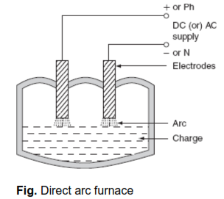
Types of arc furnaces
There are two types of arc furnaces and they are:
1. Direct arc furnace and
2. Indirect arc furnace.
(i) Direct arc furnace
When supply is given to the electrodes, two arcs are established and current passes through the charge.
As the arc is in direct contact with the charge and heat is also produced by current flowing through the charge itself, it is known as direct arc furnace.

Slide 42
Direct Arc Furnace
If the available supply is DC or 1-ø, AC, two electrodes are sufficient, if the supply is 3-ø, AC, three electrodes are placed at three vertices of an equilateral triangle.
The most important feature of the direct arc furnace is that the current flows through the charge, the stirring action is inherent due to the electromagnetic force setup by the current, such furnace is used for manufacturing alloy steel and gives purer product.
It is very simple and easy to control the composition of the final product during refining process operating the power factor of arc furnace is 0.8 lagging.
For 1-ton furnace, the power required is about 200 kW and the energy consumed is 1.0 MWh/ton.

Slide 43
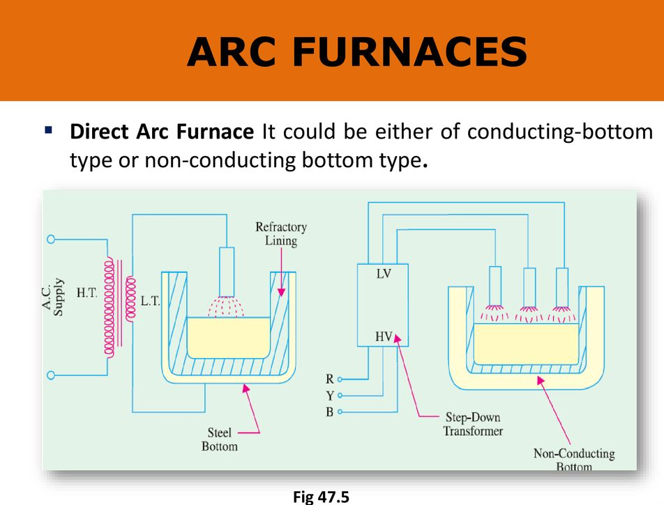

Slide 44
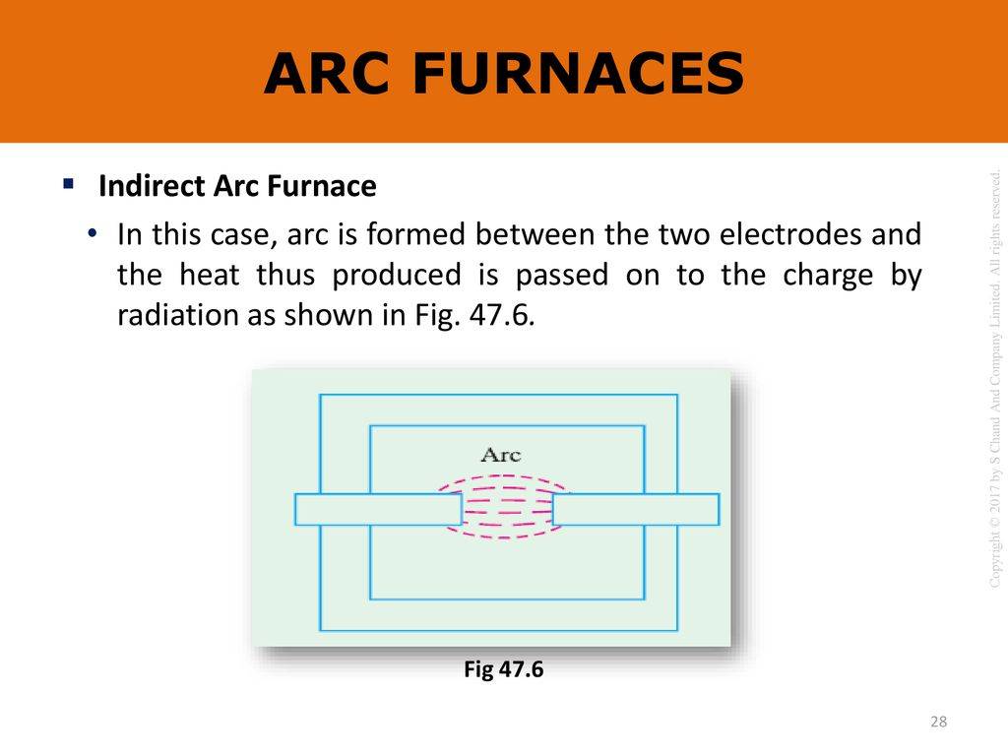

Slide 45
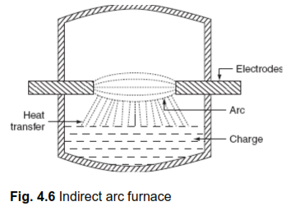
Indirect Arc Furnace
In indirect arc furnace, the arc strikes between two electrodes by bringing momentarily in contact and then withdrawing them heat so developed, due to the striking of arc across air gap is transferred to charge is purely by radiation.
These furnaces are usually 1-ø and hence their size is limited by the amount of single-phase load which can be taken from one point.
There is no inherent stirring action provided in this furnace, as current does not flow through the charge and the furnace must be rocked mechanically.

Slide 46
Indirect Arc Furnace
The electrodes are projected through this chamber at each end along the horizontal axis. This furnace is also sometimes called as rocking arc furnace.
The charge in this furnace is heated not only by radiation from the arc between electrode tips but also by conduction from the heated refractory during rocking action; so, the efficiency of such furnace is high.
The arc is produced by bringing electrodes into solid contact and then withdrawing them; power input to the furnace is regulated by adjusting the arc length by moving the electrodes.
Even though it can be used in iron foundries where small quantities of iron are required frequently, the main application of this furnace is the melting of non-ferrous metals.

Slide 47
High Frequency Heating
The main difference between the power-frequency and the high-frequency heating is that in the conventional methods, the heat is transferred either by conduction convection or by radiation, but in the high-frequency heating methods, the electromagnetic energy converted into the heat energy in side the material.
The high-frequency heating can be applied to two types of materials. The heating of the conducting materials, such as ferro-magnetic and non-ferromagnetic, is known as induction heating.
The process of heating of the insulating materials is known as dielectric heating.
The heat transfer by the conventional method is very low of the order of 0.5–20 W/sq. cm.
And, the heat transfer rate by the high-frequency heating either by induction or by dielectric heating is as much as 10,000 W/sq. cm.
Thus, the high frequency heating is most importance for tremendous speed of production.

Slide 48
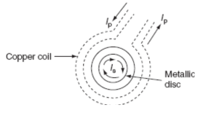
Induction Heating
The induction heating process makes use of the currents induced by the electromagnetic action in the material to be heated.
To develop sufficient amount of heat, the resistance of the material is power drawn = V²/R must be low, which is possible only with the metals, and the voltage must be higher, which can be obtained by employing higher flux and higher frequency.
Therefore, the magnetic materials can be heated than non-magnetic materials due to their high permeability.
In order to analyze the factors affecting induction heating, let us consider a circular disc to be heated carrying a current of ‘I’ amps at a frequency ‘f’ Hz.

Slide 49

Induction Heating
Heat developed in the disc is depending upon the following factors:
Primary coil current
The number of the turns of the coil
Supply frequency
The magnetic coupling between the coil and the disc
The high electrical resistivity of the disc
If the charge to be heated is non-magnetic, then the heat developed is due to eddy current loss, whereas if it is magnetic material, there will be hysteresis loss in addition to eddy current loss.
Both hysteresis and eddy current loss are depended upon frequency, but at high-frequency hysteresis, loss is very small as compared to eddy currents. The depth of penetration of induced currents into the disc is given by:

Slide 50
Induction Heating
where ρ is the specific resistance in Ω-cm, f is the frequency in Hz, and µ is the permeability of the charge.
There are basically two types of induction furnaces and they are:
1. Core type or low-frequency induction furnace
2. Coreless type or high-frequency induction furnace
Core type furnace
The operating principle of the core type furnace is the electromagnetic induction. This furnace is operating just like a transformer. It is further classified as:
1. Direct core type
2. Vertical core type
3. Indirect core type

Slide 51
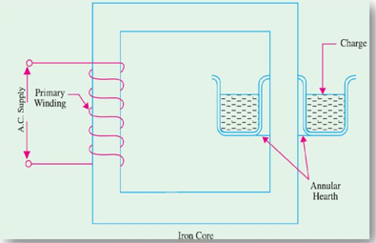
Direct core type induction furnace
The core type furnace is essentially a transformer in which the charge to be heated forms single turn secondary circuit and is magnetically coupled to the primary by an iron core.

Slide 52
Direct core type induction furnace
The furnace consists of a circular hearth in the form of a trough, which contains the charge to be melted in the form of an annular ring.
This type of furnace has the following characteristics:
This metal ring is quite large in diameter and is magnetically interlinked with primary winding, which is energized from an AC source.
The magnetic coupling between primary and secondary is very weak; it results in high leakage reactance and low pf.
To overcome the increase in leakage reactance, the furnace should be operated at low frequency of the order of 10 Hz.
When there is no molten metal in the hearth, the secondary becomes open circuited thereby cutting of secondary current.
Hence, to start the furnace, the molten metal has to be taken in the hearth to keep the secondary as short circuit.
Furnace is operating at normal frequency, which causes turbulence and severe stirring action in the molten metal to avoid this difficulty, it is also necessary to operate the furnace at low frequency.

Slide 53
Direct core type induction furnace
In order to obtain low-frequency supply, separate motor-generator set (or) frequency changer is to be provided, which involves the extra cost.
The crucible used for the charge is of odd shape and inconvenient from the metallurgical viewpoint.
If current density exceeds about 500 A/cm², it will produce high electromagnetic forces in the molten metal and hence adjacent molecules repel each other, as they are in the same direction.
The repulsion may cause the interruption of secondary circuit (formation of bubbles and voids); this effect is known as pinch effect.
The pinch effect is also dependent on frequency; at low frequency, this effect is negligible, and so it is necessary to operate the furnace at low frequency.

Slide 54
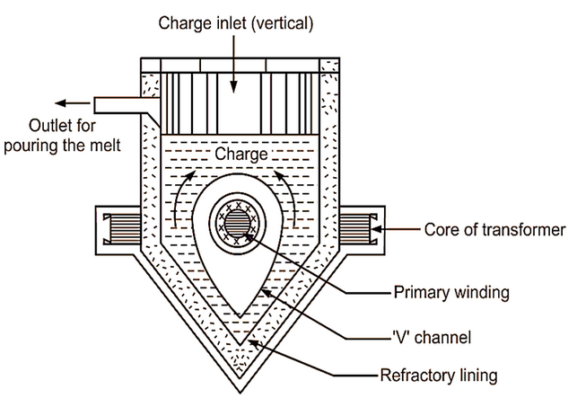
Vertical core type induction furnace
It is an improvement over the direct core type furnace, to overcome some of the disadvantages mentioned above.
This type of furnace consists of a vertical core instead of horizontal core. It is also known as Ajax–Wyatt induction furnace.

Slide 55
Vertical core type induction furnace
Vertical core avoids the pinch effect due to the weight of the charge in the main body of the crucible.
The leakage reactance is comparatively low and the power factor is high as the magnetic coupling is high compared to direct core type.
There is a tendency of molten metal to accumulate at the bottom that keeps the secondary completed for a vertical core type furnace as it consists of narrow V-shaped channel.
The inside layer of furnace is lined depending upon the type charge used. Clay lining is used for yellow brass and an alloy of magnesia and alumina is used for red brass.
The top surface of the furnace is covered with insulating material, which can be removed for admitting the charge.
Necessary hydraulic arrangements are usually made for tilting the furnace to take out the molten metal.

Slide 56
Vertical core type induction furnace
Even though it is having complicated construction, it is operating at power factor of the order of 0.8–0.83.
This furnace is normally used for the melting and refining of brass and non-ferrous metals.
Advantages:
Accurate temperature control and reduced metal losses
Absence of crucibles
Consistent performance and simple control
It is operating at high power factor
Pinch effect can be avoided

Slide 57
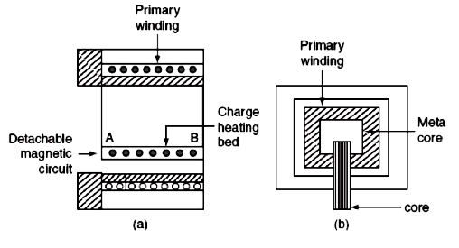
Indirect core type induction furnace
This type of furnace is used for providing heat treatment to metal. A simple induction furnace with the absence of core.

Slide 58
Indirect core type induction furnace
The secondary winding itself forms the walls of the container or furnace and an iron core links both primary and secondary windings.
The heat produced in the secondary winding is transmitted to the charge by radiation. An oven of this type is in direct competition with ordinary resistance oven.
It consists of a magnetic circuit AB is made up of a special alloy and is kept inside the chamber of the furnace.
This magnetic circuit loses its magnetic properties at certain temperature and regains them again when it is cooled to the same temperature.
When the oven reaches to critical temperature, the reluctance of the magnetic circuit increases many times and the inductive effect decreases thereby cutting off the supply heat. Thus, the temperature of the furnace can be effectively controlled.

Slide 59
Indirect core type induction furnace
The magnetic circuit ‘AB’ is detachable type that can be replaced by the other magnetic circuits having critical temperatures ranging between 400°C and 1,000°C.
The furnace operates at a p.f. of around 0.8. The main advantage of such furnace is wide variation of temperature control is possible.

Slide 60
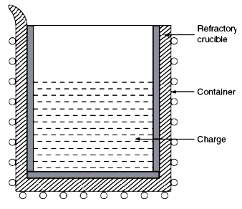
Coreless type induction furnace
It is a simple furnace with the absence of core. In this furnace, heat developed in the charge due to eddy currents flowing through it. It is also called as high frequency eddy current heating.

Slide 61
Coreless type induction furnace
The furnace consists of a refractory or ceramic crucible cylindrical in shape enclosed within a coil that forms primary of the transformer.
The furnace also contains a conducting or nonconducting container that acts as secondary.
If the container is made up of conducting material, charge can be conducting or nonconducting; whereas, if the container is made up of non-conducting material, charge taken should have conducting properties.
When primary coils are excited by an alternating source, the flux set up by these coils induce the eddy currents in the charge.
The direction of the resultant eddy current is in a direction opposite to the current in the primary coil.
These currents heat the charge to melting point and they also set up electromagnetic forces that produce a stirring action to the charge.

Slide 62
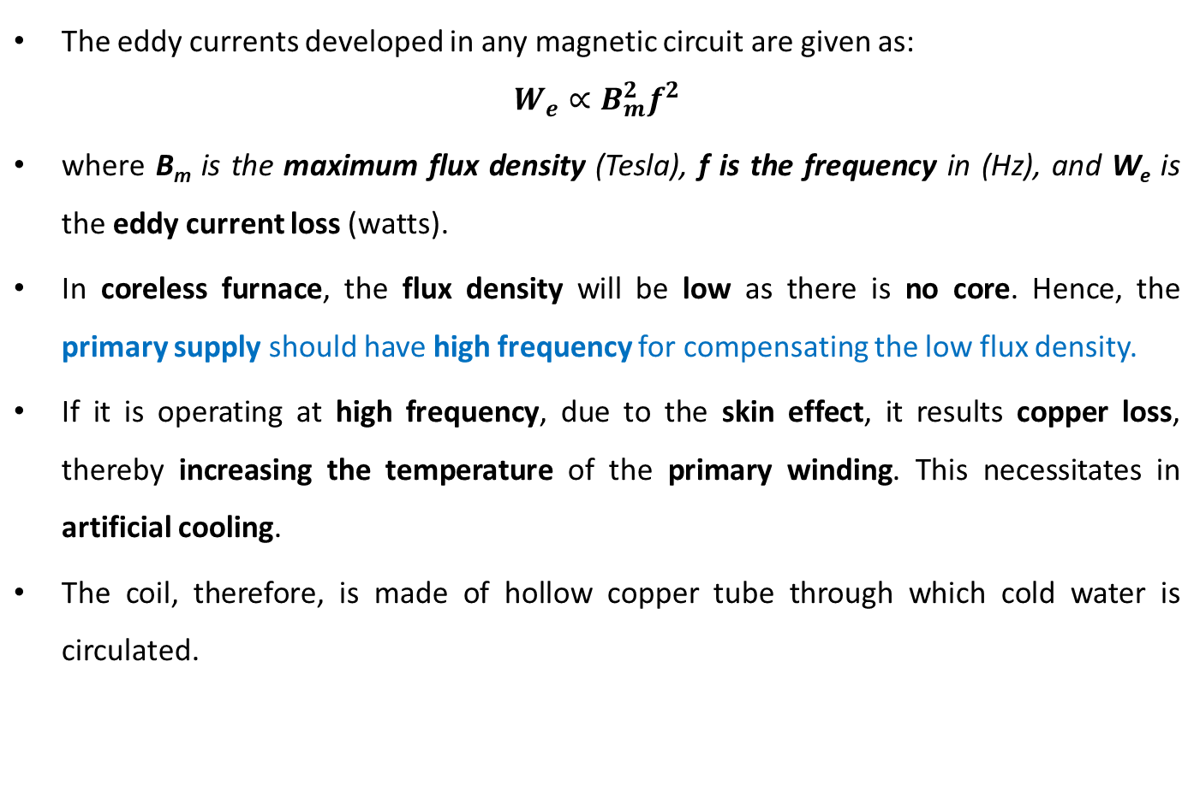
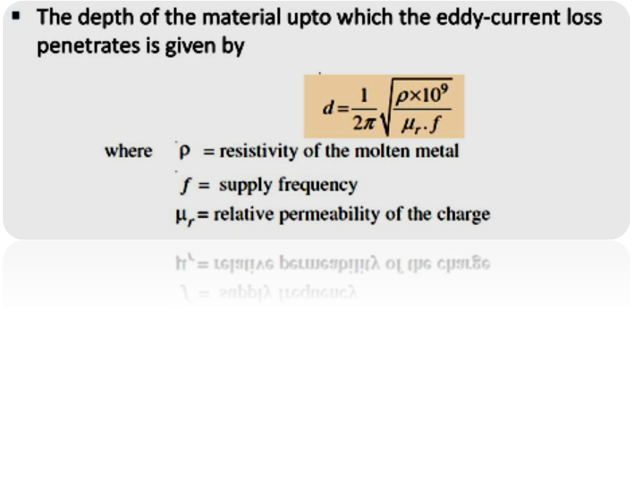
Coreless type induction furnace

Slide 63
Coreless type induction furnace
Advantages:
With the eddy current heating, the temperature control is very easy.
As the heat is produced in the body to be heated up directly. Therefore, the wastage of heat is very less.
The heating coils are not required to fit closely around the object being treated.
The heat penetration into the metal surface can be controlled to any desired depth.
The eddy current heating method is quick, clean and convenient.
Unskilled personal can also operate the heating equipment easily.
The eddy current heating can easily take place in vacuum or any other special atmosphere.
By using suitable timing devices, the amount of heat produced by the eddy current heating method can be accurately controlled.

Slide 64
Coreless type induction furnace
Disadvantages:
In case of eddy current heating, the cost of heat production is high.
The initial cost of the equipment used for eddy current heating is high.
The efficiency of the equipment used for eddy current heating is very low, about less than 50%.
Applications:
The eddy current heating is used for surface hardening process.
The eddy current heating is a convenient method for annealing.
Eddy current heating also used for soldering precisely.
It is used for drying of paints.
Eddy current heating is also employed for welding process.
It is used for forging of bolt heads and rivet heads.
It is also used for melting of various metals.
For sterilization of surgical instruments, the eddy current heating is used.

Slide 65
Dielectric Heating
The process of heating in which a high-frequency alternating electric field or radio waves or microwave electromagnetic radiation are used to heat the dielectric materials is known as dielectric heating.
Dielectric heating is also known as electronic heating, radio frequency (R.F.) heating, high frequency heating and diathermy.
Dielectric heating is mainly used for heating of insulators like wood, plastics and ceramics, etc. which cannot be heated easily and uniformly by the other methods of heating.
The frequency of the input supply required for dielectric heating ranges from 10 MHz to 15 MHz and the applied voltage is 20 kV.

Slide 66
Dielectric Heating
When non-metallic materials i.e., insulators such as wood, plastics, and China glass are subjected to high-voltage alternating electric field, the atoms get stresses, and due to interatomic friction caused by the repeated deformation and the rotation of atomic structure (polarization), heat is produced. This is known as dielectric loss.
This dielectric loss in insulators corresponds to hysteresis loss in ferro-magnetic materials.
This loss is due to the reversal of magnetism or magneto molecular friction. These losses developed in a material that has to be heated.
An atom of any material is neutral, since the central positive charge is equals to the negative charge. So that, the centers of positive and negative charges coincide as long as there is no external field is applied.
When this atom is subjected to the influence of the electric field, the positive charge of the nucleus is acted upon by some force in the direction of negative charges in the opposite direction.

Slide 67
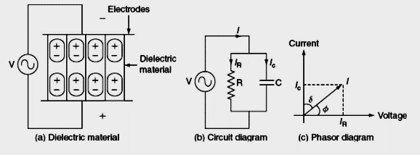
Dielectric Heating
If we apply alternating voltage across the capacitor plates, we will get alternating electric field. Electric dipoles will also try to change their orientation according to the direction of the impressed electric field.
In doing so, some energy will be wasted as inter-atomic friction, which is called dielectric loss.
As there is no perfect conductor, so there is no perfect insulator. All the dielectric materials can be represented by a parallel combination of a leakage resistor ‘R’ and a capacitor ‘C’.

Slide 68
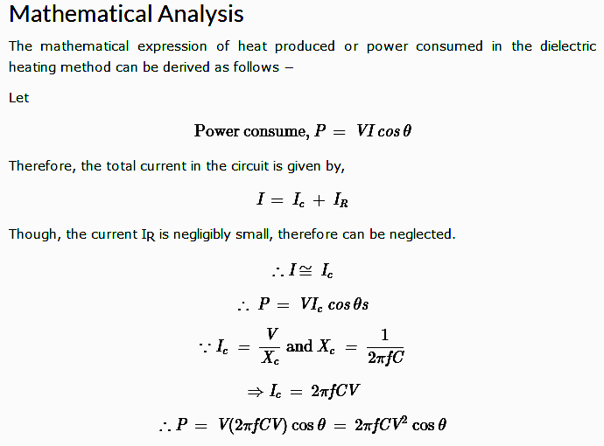
Dielectric Heating
If an AC voltage is applied across a piece of insulator, an electric current flows; total current ‘I’ supposed to be made up of two components I_{C} and I_{R}, where I_{C} is the capacitive current leading the applied voltage by 90° and I_{R} is in phase with applied voltage.

Slide 69
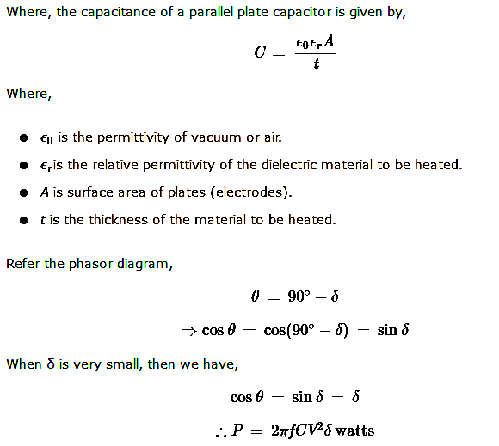
Dielectric Heating

Slide 70
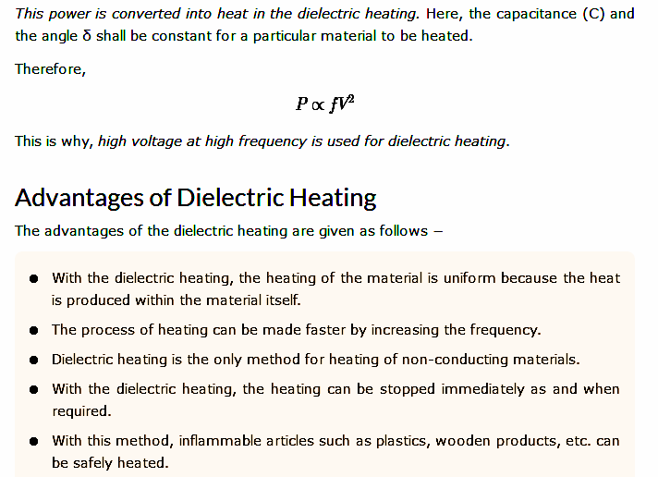
Dielectric Heating

Slide 71
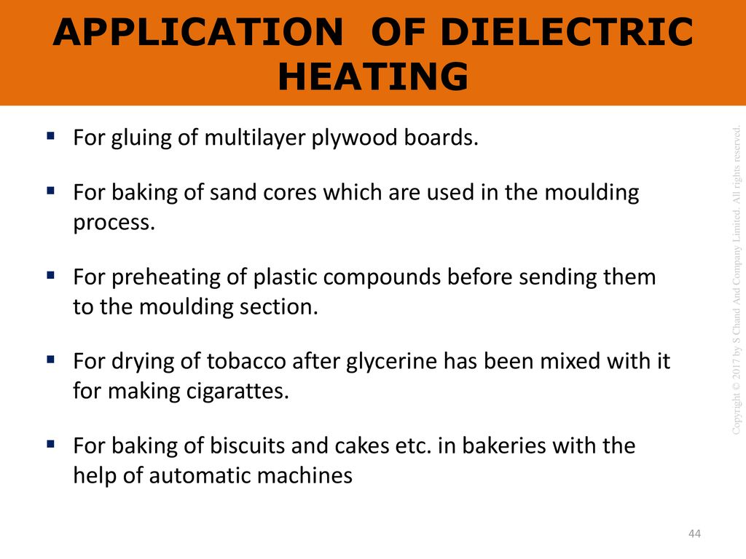

Slide 72
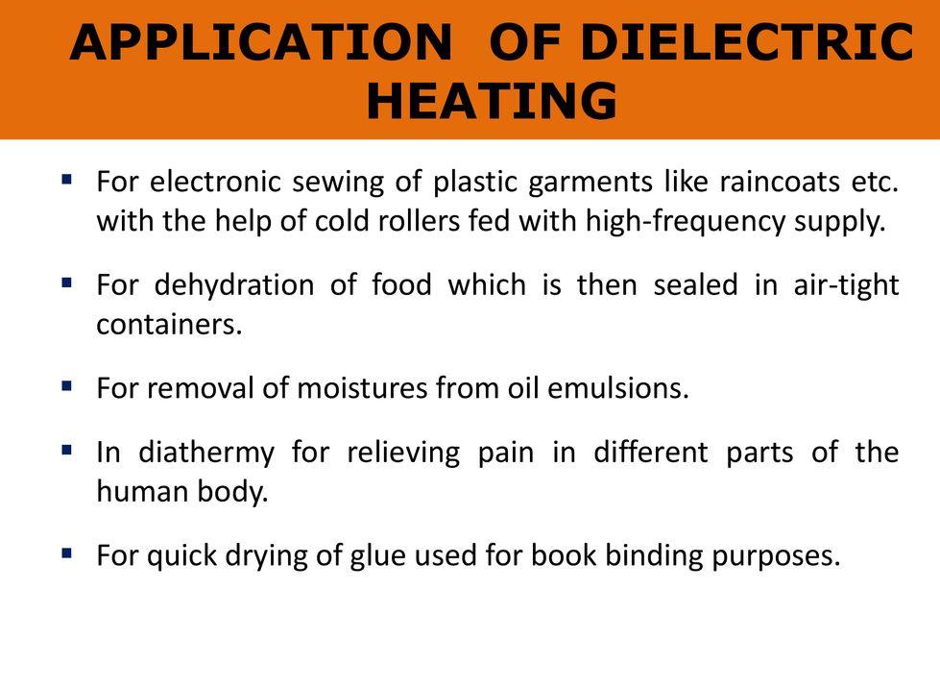

Slide 73
Differences between Induction Heating and Dielectric Heating
Basis of Difference | Induction Heating | Dielectric Heating
Definition | The type of electric heating in which heating a body is done by means of electromagnetic induction is known as induction heating. | The type of electric heating in which a high-frequency alternating electric field is used to heat the dielectric materials is known as dielectric heating.
Principle of operation | The working of the induction heating is based on the principle electromagnetic induction. | The working of dielectric heating is based on the principle of electrostatic induction.
Frequency of AC supply used | The frequency of AC supply employed in induction heating is medium, usually ranging from 100 kHz to 500 kHz. | The high frequency AC supply is used in the dielectric heating. The typical frequency range is 10 MHz to 50 MHz.
Cause of heating | In case of induction heating, the eddy currents induced in the object due to electromagnetic induction are the main cause of production of heat. | The interatomic friction in the dielectric material is the cause of production of heat in case of dielectric heating.
Area of heat production | In the induction heating, the heat is produced on the surface of body. | In the dielectric heating, the heat is produced inside the material.

Slide 74
Differences between Induction Heating and Dielectric Heating
Basis of Difference | Induction Heating | Dielectric Heating
Types | There are two types of induction heating namely ‘direct induction heating’ and ‘indirect induction heating’. | There is no such further classification of dielectric heating.
Material to be heated | Induction heating used for heating of conducting materials such as metals. | Dielectric heating is used for heating of insulating and dielectric materials like wood, plastic, etc.
Cost of heating equipment | The heating equipment used for induction heating are relatively less costly | The heating equipment used for dielectric heating is expensive.
Heat distribution in body | In case of induction heating, the heat distribution is non-uniform. | Dielectric heating heats the body uniformly.
Applications | The applications of induction heating are in surface hardening, soldering, brazing, annealing, etc. | The applications of dielectric heating involves drying of wood, food processing, cooking and baking, gluing, etc.

